Slide 1
Initial presentation
Sem 4 Thesis
PPM of a Neutron star: Unveiling hot spot geometry

Slide 2
General procedure
Selection of a Neutron star.
Appropriate data from NICER using HEASoft and CALDB
Filtering of data
Using X-PSI to model and find the radius and mass of the pulsar

Slide 3
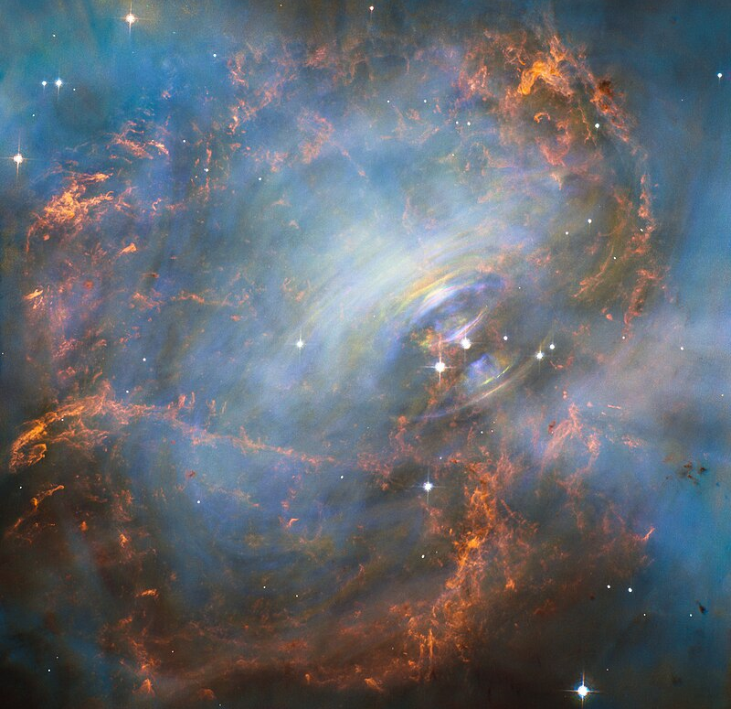
What is a Neutron star?
A neutron star is an extraordinarily dense remnant of a massive star that has undergone a supernova explosion. These compact objects are characterized by extreme densities, strong magnetic fields, and rapid rotation. The concept of neutron stars was first proposed in 1934 by Walter Baade and Fritz Zwicky, who suggested that supernovae could result in the formation of stars composed primarily of neutrons. This idea was further developed in 1939 by J. Robert Oppenheimer and George Volkoff, who applied general relativity to model the structure of such stars. https://www.cambridge.org/core/books/abs/pulsar-astronomy/1-the-discovery-of-pulsars/FA9A870E5502846849675D0B5728CA5B?utm_source=chatgpt.com

Slide 4
Formation and Structure
Neutron stars are formed when the core of a massive star collapses under gravity during a supernova explosion. If the remaining mass is between about 1.4 and 2.16 solar masses, electron degeneracy pressure is insufficient to halt the collapse, and protons and electrons combine to form neutrons. This results in a compact object with a radius of approximately 10 kilometers (sun-695,700 kilometers) and a density comparable to that of atomic nuclei.
Equation of State and Internal Composition
The internal composition of neutron stars is governed by the equation of state (EoS) of ultra-dense matter, which remains uncertain due to the challenges in modeling matter at such extreme densities. The Tolman-Oppenheimer-Volkoff (TOV) equation, derived from general relativity, describes the balance between gravity and internal pressure in these stars. The core may contain exotic states of matter, such as hyperons, deconfined quarks, or Bose-Einstein condensates, and phenomena like superfluidity and superconductivity are expected to occur.

Slide 5
Magnetic Fields and Rotation
Neutron stars possess extremely strong magnetic fields, ranging from 10^8 to 10^15 gauss. These fields are believed to originate from the conservation of magnetic flux during the collapse of the star. The rapid rotation of neutron stars, with periods ranging from milliseconds to seconds, is a consequence of angular momentum conservation during the collapse. Some neutron stars, known as pulsars, emit beams of electromagnetic radiation from their magnetic poles, which can be observed as periodic pulses if the beam crosses Earth's line of sight.

Slide 6
What is a Pulsar?
A pulsar is a highly magnetized, rotating neutron star that emits beams of electromagnetic radiation from its magnetic poles. These beams are observable when they sweep past the Earth, appearing as regular pulses of radiation. The discovery of pulsars in 1967 by Jocelyn Bell Burnell and Antony Hewish marked a significant milestone in astrophysics, providing the first direct evidence of neutron stars.
Discovery and Initial Observations
The first pulsar, designated CP 1919 (now known as PSR B1919+21), was discovered through its regular radio pulses with a period of 1.337 seconds. The regularity of these pulses initially led to speculation about extraterrestrial origins, but subsequent observations confirmed their astrophysical nature. This discovery was pivotal in confirming the existence of neutron stars, as pulsars were soon understood to be rotating neutron stars emitting beams of radiation.

Slide 7
Radiation Mechanisms
The radiation emitted by pulsars spans a wide range of the electromagnetic spectrum, including radio, optical, X-ray, and gamma-ray wavelengths. The high brightness temperatures observed in pulsar emissions suggest that these processes are highly efficient and involve collective behavior of particles.

Slide 8
Pulsar Timing and Applications
Pulsars are renowned for their remarkable timing stability, making them precise cosmic clocks. This stability has been utilized in various applications, including tests of general relativity. The discovery of the Hulse–Taylor binary pulsar (PSR B1913+16) provided the first indirect evidence for gravitational waves, as the orbital decay of the system matched predictions from general relativity. Pulsar timing has also been instrumental in detecting exoplanets, as variations in pulse arrival times can indicate the presence of orbiting bodies.
Evolution and Population
Pulsars are born from the remnants of massive stars that have undergone supernova explosions. Over time, their rotation slows due to energy loss through radiation and particle winds. Some pulsars, known as millisecond pulsars, have been spun up through accretion of matter from a companion star, resulting in extremely rapid rotation rates. The study of pulsar populations provides insights into the life cycles of stars and the dynamics of binary systems.

Slide 9
Equation of State (EoS)
The Equation of State (EoS) is a fundamental concept in physics that describes the relationship between state variables such as pressure, temperature, volume, and internal energy. In the context of neutron stars, the EoS characterizes how matter behaves under the extreme densities and pressures found within these compact objects. Understanding the EoS is crucial for predicting neutron star properties like mass, radius, and internal composition.

Slide 10
Equation of State in Neutron Stars
Neutron stars are remnants of massive stars that have undergone supernova explosions. They are incredibly dense, with masses about 1.4 times that of the Sun compressed into a radius of approximately 10 kilometers. The EoS for neutron star matter must account for:
Degenerate Fermions: Neutrons, protons, and electrons are packed densely, and their quantum mechanical properties significantly influence the EoS.
Strong Nuclear Forces: Interactions between nucleons (neutrons and protons) are governed by the strong nuclear force, which becomes significant at high densities.
Relativistic Effects: At such high densities, general relativity must be considered to describe the gravitational behavior accurately.

Slide 11
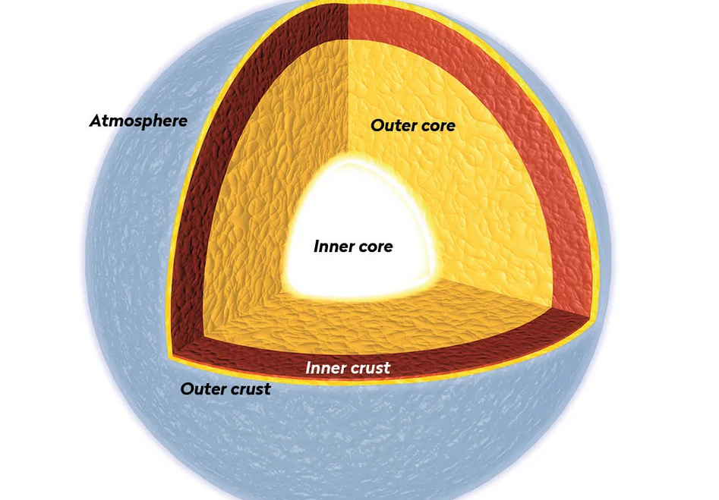
Qualitative Description of Neutron Star EoS
Outer Crust: Composed of nuclei and electrons, the pressure is primarily due to electron degeneracy.
Inner Crust: Features a lattice of nuclei immersed in a sea of neutrons and electrons.
Outer Core: Consists mainly of neutrons, with a small fraction of protons, electrons, and muons.
Inner Core: The composition is uncertain; possibilities include hyperons, meson condensates,or deconfined quark matter.
https://www.skyatnightmagazine.com/space-science/neutron-star

Slide 12
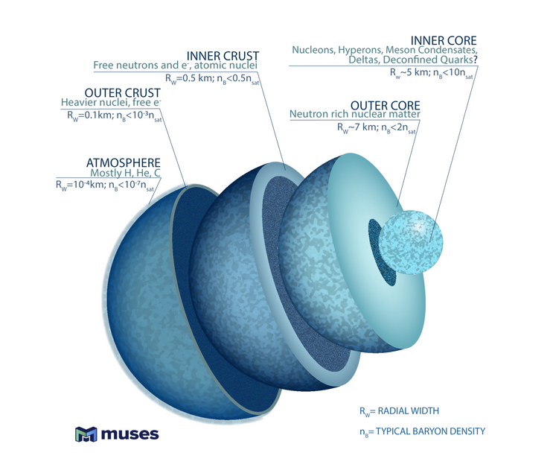
https://physics.illinois.edu/research/highlights/neutronstars

Slide 13
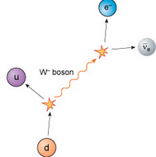
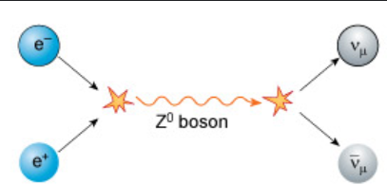
Quantitative Models of Neutron Star EoS
a. Non-Relativistic Potential Models
These models use nucleon-nucleon interactions derived from experimental data to calculate the EoS. These models are effective at lower densities but may not capture all relevant physics at higher densities.
b. Relativistic Mean Field (RMF) Models
RMF models incorporate relativistic effects by treating nucleons as Dirac particles interacting via meson exchange. These models can be calibrated to reproduce nuclear matter properties and extended to higher densities relevant for neutron stars.
c. Quark Matter Models
At extremely high densities, nucleons may dissolve into their constituent quarks, leading to deconfined quark matter. Models like the Nambu–Jona-Lasinio (NJL) model are used to describe this phase. The transition from hadronic to quark matter can significantly affect the EoS and, consequently, neutron star properties.

Slide 14
Observational Constraints on the EoS
Mass Measurements: Precise measurements of neutron star masses, especially those
exceeding 2 solar masses, set lower limits on the stiffness of the EoS.
Radius Measurements: Radius estimates from X-ray observations help constrain the EoS by
limiting the possible mass-radius relationships.
Gravitational Waves: Events like GW170817, a binary neutron star merger, provide information on
the tidal deformability of neutron stars, which is sensitive to the EoS.

Slide 15
Advantages of Determining the EoS for Pulsars
Pulsars are rotating neutron stars emitting beams of electromagnetic radiation. Understanding their EoS offers several benefits:
Testing Fundamental Physics: Precise timing of pulsars allows tests of general relativity and alternative theories of gravity.
Understanding Dense Matter: The EoS provides insights into the behavior of matter at densities beyond those achievable in laboratories.
Astrophysical Applications: Knowledge of the EoS aids in modeling supernovae, neutron star mergers, and the evolution of compact binaries.

Slide 16
References:
1. Lattimer, J. M., & Prakash, M. (2004). The physics of neutron stars. Science, 304(5670), 536-542.
https://link.springer.com/referenceworkentry/10.1007/978-3-319-20794-0_54-1
2. Oppenheimer, J. R., & Volkoff, G. M. (1939). On Massive Neutron Cores. Physical Review, 55(4), 374-381.
https://en.wikipedia.org/wiki/Tolman%E2%80%93Oppenheimer%E2%80%93Volkoff_equation
3. Steiner, A. W., Lattimer, J. M., & Brown, E. F. (2010). The Equation of State from Observed Masses and Radii of Neutron Stars. The Astrophysical Journal, 722(1), 33-54.
https://arxiv.org/abs/1205.6871

Slide 17
Different types of pulsars
1. Radio Pulsars
Properties:
Emit regular pulses of radio waves detectable from Earth.
Periods typically range from milliseconds to a few seconds.
Pulse profile is stable over long time scales.
Energy is primarily lost through magnetic dipole radiation and particle winds.
Examples: PSR B0329+54, PSR B1919+21 (the first discovered pulsar by Jocelyn Bell Burnell and Antony Hewish in 1967).

Slide 18
2. Millisecond Pulsars (MSPs)
Properties:
Very short spin periods: 1–10 milliseconds.
Extremely stable rotators – used as cosmic clocks.
Thought to be "recycled" by accretion of matter from a binary companion (spin-up mechanism).
Weak magnetic fields (~10^8 Gauss).
Examples: PSR B1937+21 (first discovered MSP), PSR J1231−1411.

Slide 19
3. X-ray Pulsars
Properties:
Detected in X-rays, typically due to accretion of matter from a binary companion.
Often found in X-ray binary systems.
Radiation is generated by hotspots on the magnetic poles due to accreted matter.
Can show irregular timing due to changes in accretion rates.
Types:
Accretion-powered X-ray pulsars: Powered by matter falling from companion stars.
Rotation-powered X-ray pulsars: Similar to radio pulsars but visible in X-rays.
Examples: Her X-1, Vela X-1.

Slide 20
4. Gamma-ray Pulsars
Properties:
Emit pulsed gamma-ray radiation.
Often also detectable in radio or X-ray wavelengths.
More energetic than typical radio pulsars.
Spin-down is rapid due to strong magnetic dipole radiation.
Examples: Geminga (not detected in radio), PSR J1836+5925.

Slide 21
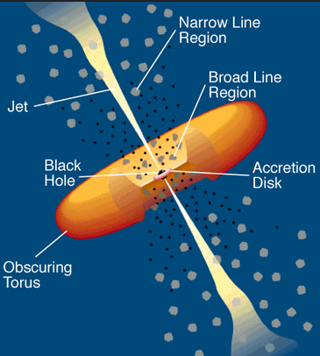
Active Galactic Nucleus (AGN)
An Active Galactic Nucleus (AGN) is a compact region at the center of a galaxy that emits an extraordinary amount of energy across the electromagnetic spectrum. This emission is not attributed to the stars, dust, or gas in the galaxy but is believed to result from accretion of matter onto a supermassive black hole (SMBH) at the galaxy's core. AGN are among the most luminous and energetic phenomena in the universe, and their study has been pivotal in understanding galaxy evolution and high-energy astrophysical processes.

Slide 22
Accretion onto Supermassive Black Holes
At the heart of an AGN lies a SMBH with masses ranging from 10^6 to 10^10 solar masses. Matter from the surrounding galaxy is drawn towards the SMBH, forming an accretion disk. As matter spirals inwards, gravitational potential energy is converted into kinetic energy and then into thermal energy, emitting radiation across the electromagnetic spectrum. This process is highly efficient, with up to 10% of the accreted mass-energy converted into radiation.
Emission Regions
The AGN structure comprises several distinct regions:
Accretion Disk: A geometrically thin, optically thick disk emitting primarily in the optical to ultraviolet range.
Broad-Line Region (BLR): Located just outside the accretion disk, this region contains high-velocity gas clouds that produce broad emission lines due to Doppler broadening.
Narrow-Line Region (NLR): Situated further out, this region contains lower-velocity gas clouds, resulting in narrower emission lines.
Dusty Torus: A doughnut-shaped structure of dust and gas that can obscure the central regions, depending on the observer's line of sight.
Relativistic Jets: In some AGN, collimated jets of relativistic particles are ejected perpendicular to the accretion disk, emitting synchrotron radiation observable in radio to gamma-ray wavelengths.

Slide 23
Evolution of star into a pulsar
1. Birth of a Massive Star
Initial Mass: The star must be massive — typically 8 to 25 times the mass of the Sun (M☉) — to eventually form a neutron star or pulsar.
Nuclear Fusion: The star spends most of its life fusing hydrogen into helium in its core, producing radiation pressure that balances gravity.
Main Sequence: This phase lasts millions of years, depending on the star’s mass. More massive stars burn fuel more quickly.

Slide 24

2. Red Supergiant Phase
Fuel Exhaustion: When hydrogen is depleted, the star begins fusing helium, then progressively heavier elements like carbon, oxygen, silicon, etc., until iron (Fe) builds up in the core.
Formation of an Iron Core: Iron cannot undergo fusion to release energy (endothermic reaction), so the core becomes inert, growing increasingly massive.
3. Core Collapse
Chandrasekhar Limit: When the iron core exceeds about 1.4 M☉, it can no longer support itself against gravity through electron degeneracy pressure.
Electron Capture: Electrons and protons combine via inverse beta decay:
This creates neutrons and releases a huge burst of neutrinos.
Collapse to Nuclear Density: The core collapses in milliseconds to a density of about 10^14-10^15 g/cm^3— similar to atomic nuclei.

Slide 25
4. Supernova Explosion (Type II)
Rebound Shock: The inner core collapse halts at nuclear density due to neutron degeneracy pressure, causing the infalling outer layers to bounce off the core.
Shockwave and Neutrinos: The rebound, aided by neutrino heating, creates an outward shockwave, expelling the outer layers in a supernova explosion.
Resulting Object: The remaining object is a neutron star — typically about 1.4–2.0 M☉, with a radius of ~10–12 km.
5. Formation of a Pulsar
Rapid Rotation: Due to conservation of angular momentum, the collapsing core spins extremely fast — often tens to hundreds of times per second.
Intense Magnetic Fields: The magnetic field is conserved and compressed, increasing to 10^8 to 10^15 Gauss.
Misalignment of Axes: The magnetic axis is not aligned with the rotation axis. The strong magnetic field channels particles into beams that radiate from the magnetic poles.
Lighthouse Effect: As the star spins, these beams sweep across space. If Earth lies in the path of the beam, we observe regular pulses of radiation — a pulsar.

Slide 26
End Stages & Lifespan of Pulsars
Spin-down: Over time, pulsars lose rotational energy via electromagnetic radiation and particle winds, causing them to slow down.
Death Line: When the pulsar slows enough, it stops emitting visible pulses. It becomes a "dead" neutron star.
Millisecond Pulsars: Some old pulsars can be "spun up" again by accreting matter from a binary companion, becoming millisecond pulsars.

Slide 27
Bhattacharya, D., & van den Heuvel, E. P. J. (1991). Formation and evolution of binary and millisecond radio pulsars. Physics Reports, 203(1), 1–124 https://ui.adsabs.harvard.edu/abs/1991PhR...203....1B/abstract
Ferdman, R. D., et al. (2013). The double pulsar: evidence for neutron star formation without an iron core-collapse supernova. arXiv preprint arXiv:1302.2914.
https://arxiv.org/abs/1302.2914

Slide 28
NICER
The Neutron star Interior Composition ExploreR (NICER) is an NASA experiment placed on the International Space Station (ISS).
NICER observe the sky in the X-ray band (0.2-12 keV) with large collective area and fine time resolution. It was launched on a SpaceX Falcon 9 rocket on June 3, 2017, and commenced operations on June 14. The mission was approved for 18 months of operations that was extended in March 2019 and is still operating.
Mission Characteristics-
Energy Range : 0.2–12 keV
Special Features : Concentrator optics with high temporaral and moderate spectral resolution.
Payload :
X-ray Timing Instrumen (XTI) consists of 56 concentrator optics, providing a 5 arcmin non-imaging field of view onto a matching set of silicon drift detectors (SSDs). Energy range; 0.2- 12 keV Energy Resolution : 85 eV at 1 keV; 137 eV at 6 keV Effective area : >2000 cm2 at 1.5 keV Time resolution : 300ns

Slide 29
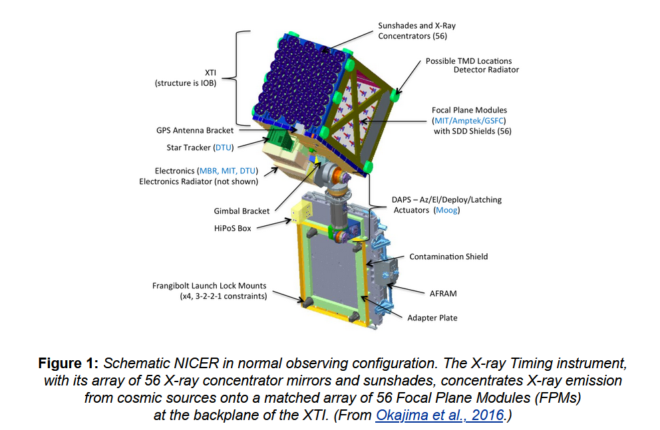
https://heasarc.gsfc.nasa.gov/docs/nicer/mission_guide/

Slide 30
PSR J1231−1411
PSR J1231−1411 is a nearby millisecond pulsar (MSP) that has garnered significant attention in astrophysical research due to its unique properties and the insights it offers into neutron star structure and behavior. Discovered through gamma-ray observations by the Fermi Large Area Telescope (LAT) and subsequently identified in radio frequencies, this pulsar has become a focal point for studies utilizing X-ray observations, particularly with the Neutron Star Interior Composition Explorer (NICER).
https://papers.cool/arxiv/2409.14923

Slide 31
Fundamental Properties
Spin Period: PSR J1231−1411 exhibits a rapid rotation with a spin period of approximately 3.68 milliseconds, categorizing it as a millisecond pulsar.
Distance: It is located at an estimated distance of about 0.4 kiloparsecs (approximately 1,300 light-years) from Earth, making it one of the closer MSPs and thus more accessible for detailed study.
Binary System: This pulsar is part of a binary system, with a low-mass companion star. The orbital characteristics and interactions within this system provide valuable data for understanding binary evolution and mass transfer processes.
https://arxiv.org/abs/2409.14923

Slide 32

Mass and Radius Constraints
Determining the mass and radius of neutron stars like PSR J1231−1411 is crucial for constraining the equation of state (EOS) of ultra-dense matter.
Qi et al. (2025):
Using pulse profile modeling with NICER and XMM-Newton data, they inferred a gravitational mass of 1.12±0.07 M⊙ and an equatorial radius of
Their model incorporated a single-temperature elongated hot spot and a crescent-shaped hot spot, suggesting a complex magnetic field structure.

Slide 33
Salmi et al. (2024): Employing Bayesian parameter inference, they estimated a mass of 1.04−0.03+0.05 M⊙ and a radius of 12.6±0.312.6 km. Their findings also indicated non-antipodal hot spot configurations, reinforcing the notion of a non-centered dipole magnetic field.
The discrepancies between these studies highlight the challenges in modeling neutron star emissions and the sensitivity of inferred parameters to the assumed emission geometries and modeling techniques.

Slide 34
Magnetic Field Complexity
The non-antipodal hot spot configurations inferred from X-ray observations suggest that PSR J1231−1411 possesses a complex magnetic field structure, deviating from the traditional centered dipole model. Such complexities can arise from multipolar magnetic field components or offset dipole configurations. Understanding these structures is essential for comprehending the pulsar's emission mechanisms and the evolution of its magnetic field over time.

Slide 35
Standard Pulsar: Typically exhibits two antipodal hot spots aligned with the magnetic poles,
resulting in symmetric pulse profiles.
PSR J1231−1411: Displays asymmetric, non-antipodal hot spots—one elongated and one
crescent-shaped—indicative of a complex magnetic field structure and resulting in asymmetric pulse profiles.
Non-antipodal hot spots refer to thermal emission regions on the surface of a neutron star (typically near its magnetic poles) that are not located at opposite ends of the star (i.e. not 180° apart, which is what we’d expect from a perfectly symmetric dipole magnetic field).
In a typical pulsar:
The magnetic field is modeled as a centered dipole, like a bar magnet.
These hot spots form because charged particles accelerated along magnetic field lines return to the stellar surface and heat the polar regions.
In pulsars with non-antipodal hot spots (like PSR J1231−1411):
The magnetic field is not a pure dipole—it may include higher-order multipole components (quadrupole, octupole, etc.) or be off-centered.
The hot spots are: Not exactly opposite each other.
Often asymmetrical in shape (e.g., elongated, crescent-shaped).
Sometimes even offset from the magnetic axis.

Slide 36
PSR J1231-1411 revisited: Pulse Profile Analysis of X-ray Observation
https://arxiv.org/abs/2502.09147
A NICER View of PSR J1231-1411: A Complex Case
https://arxiv.org/abs/2409.14923

Slide 37
Advantages for Astronomical Research
Magnetic Field Studies: Its complex magnetic field structure provides an opportunity to study non-standard magnetic configurations in neutron stars.
Binary Evolution: As part of a binary system, PSR J1231−1411 allows for the study of mass transfer, orbital dynamics, and the recycling process that spins up neutron stars to millisecond periods.

Slide 38
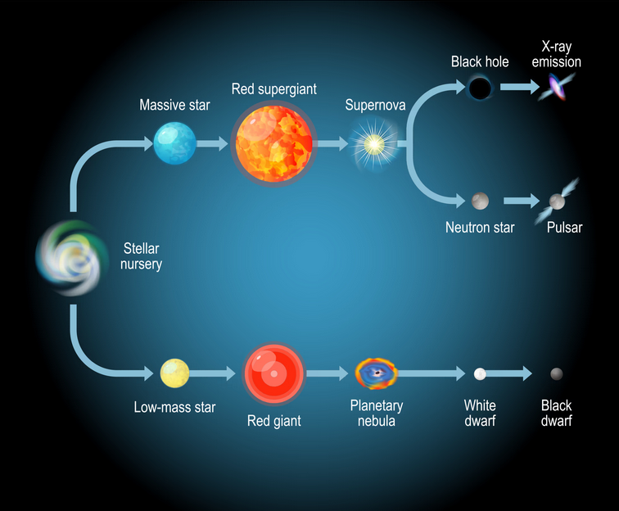

Slide 39
Companion Star
PSR J1231−1411 is a millisecond pulsar (MSP) in a binary system with a low-mass white dwarf companion.
Observations using the Gemini South telescope have identified the companion star to PSR J1231−1411. The star has an apparent magnitude of g=25.40±0.23, indicating it is faint and challenging to observe. Its optical colors and brightness suggest it is a helium-core white dwarf (He WD) .
Companion's effective temperature to be below 4000 K, classifying it as a cool white dwarf.
The cooling age is estimated to be over 5 billion years.
The white dwarf likely possesses a thin hydrogen envelope. Such envelopes are necessary for white dwarfs to cool to the observed low temperatures. This thinness may result from hydrogen shell flashes or irradiation-driven mass loss due to the pulsar's emission.
https://arxiv.org/abs/1511.01319

Slide 40
PSR J1231−1411 and its white dwarf companion form a close binary system. The pulsar's rapid rotation suggests it was spun up through accretion of matter from the companion during its earlier evolutionary stages. This accretion likely ceased as the companion evolved into a white dwarf, leaving behind the current system configuration.
Apparent magnitude (symbol: m) is a measure of how bright a celestial object appears to an observer on Earth.
It does not tell you how luminous the object actually is, but rather how bright it appears from Earth.
A lower (or more negative) magnitude means the object is brighter.
A higher (or more positive) magnitude means the object is fainter.
The faintest objects visible to the naked eye under dark skies are around +6.0.

Slide 41
Summary of research paper 1
PSR J0437−4715
A NICER View of the Nearest and Brightest Millisecond Pulsar: PSR J0437−4715
This study aims to determine the pulsar's mass, radius, and the properties of its hot X-ray emitting regions, providing insights into the equation of state (EoS) of dense matter in neutron stars.

Slide 42
Overview of PSR J0437−4715
Discovery: Discovered in 1993, PSR J0437−4715 is the closest known millisecond pulsar, located approximately 156.98 ± 0.15 parsecs away.
Binary System: It resides in a binary system with a 0.2 M⊙ helium-core white dwarf companion.
Spin Frequency: The pulsar has a spin frequency of 174 Hz.
Inclination Angle: The system's inclination angle is 137.5°, favorable for measuring the Shapiro delay in radio pulses, providing an independent mass constraint.

Slide 43
Data Acquisition and Processing
The analysis utilized NICER's X-ray Timing Instrument (XTI) data collected between July 6, 2017, and October 11, 2021, resulting in approximately 1.328 Ms of usable data after stringent filtering.
Optimal Pointing: To minimize background contamination from a nearby Seyfert II active galactic nucleus (AGN), NICER was pointed 1.15 arcminutes southwest of the pulsar, improving the signal-to-noise ratio by 16%.
Event Selection: Events were selected within the photon energy range of 0.3–3.0 keV, excluding energies below 0.3 keV to avoid calibration issues and optical loading effects.

Slide 44
Background Estimation: A "Delta" data set was constructed using standard NICER Level 2 processing, applying filters to remove time intervals with high particle background and other anomalies.
Instrument Response Models: Custom ancillary response files (ARFs) and redistribution matrix files (RMFs) were generated using NICER’s ‘nicerrf’ and ‘nicerrmf’ tools, accounting for the off-axis pointing and time-variable number of active detectors.
Phase-Folding: The event data were phase-folded using the ephemeris obtained from the Parkes Pulsar Timing Array (PPTA) radio timing solutions, ensuring accurate alignment with the pulsar's rotational period.

Slide 45
Modeling and Analysis
The study employed the X-ray Pulse Simulation and Inference (X-PSI) code to model the X-ray pulse profiles. The analysis incorporated Bayesian inference techniques to estimate the pulsar's mass, radius, and the properties of its hot X-ray emitting regions.
Summary
This study provides a detailed and comprehensive analysis of PSR J0437−4715 using NICER data, employing advanced modeling techniques to derive precise measurements of the pulsar's mass, radius, and hot X-ray emitting regions. The incorporation of tight priors from radio timing data enhances the reliability of the results, offering valuable insights into the equation of state of dense matter in neutron stars.

Slide 46
Summary of research paper 2
PSR J1231−1411
A NICER View of PSR J1231−1411: A Complex Case
Detailed Bayesian analysis of the millisecond pulsar PSR J1231−1411, utilizing data from the Neutron Star Interior Composition Explorer (NICER) and XMM-Newton. The primary objective was to constrain the neutron star's mass, radius, and the geometry of its X-ray emitting regions.​

Slide 47
Data Acquisition and Processing
NICER Data: The NICER dataset was produced using HEASoft 6.32.1 and CALDB xti20221001. Data from the full NICER mission up through May 14, 2023, were selected, totaling approximately 3.53 Ms of exposure time before any filtering. Standard Level 2 processing was performed using the task ‘nicer12’ .Subsequent cuts were applied to exclude data with magnetic cutoff rigidity below 4 GeV, planetary K-index above 3, overshoot rate exceeding 0.05 counts per second per Focal Plane Module (FPM), or a median undershoot rate above 0.02 counts per second per FPM. These cuts reduced the exposure to 81% of the original Level 2 exposure. A background light curve was generated using 2–10 keV photons, and times with rates exceeding 1.25 counts per second were discarded to minimize contamination.

Slide 48
XMM-Newton Data: The study also incorporated data from XMM-Newton to complement the NICER observations. The specific details of the XMM-Newton data processing and integration with NICER data are discussed in the full paper.

Slide 49
Weak Interpulse Feature: The pulse profile exhibited a weak interpulse feature, complicating the interpretation of the emission geometry.
Non-Antipodal Hot Regions: The best-fitting models indicated non-antipodal hot regions, suggesting a complex magnetic field structure that deviates from the simple centered dipole model.

Slide 50
Conclusion
This comprehensive analysis of PSR J1231−1411 provides valuable insights into the neutron star's properties and emission geometry. The study underscores the complexities involved in modeling X-ray emission from millisecond pulsars and the importance of incorporating detailed observational data to constrain theoretical models.

